Slide 1
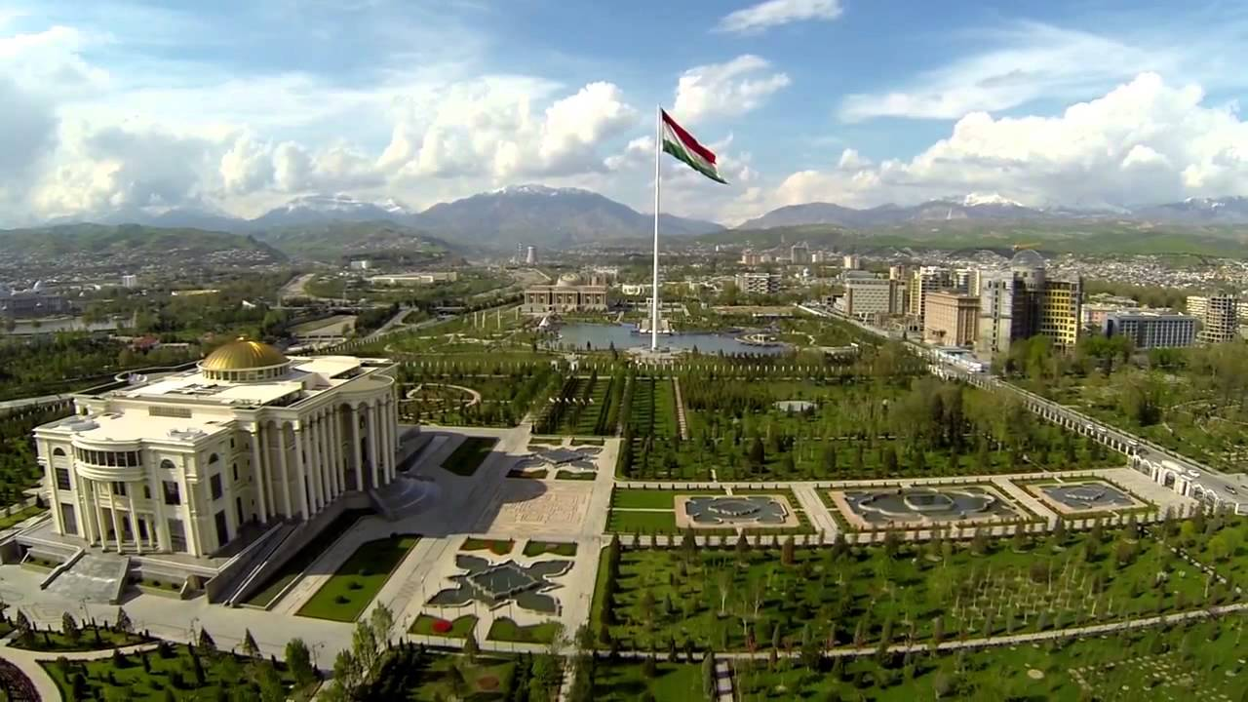
Meeting of the National Development Council under the Chairmanship of the Founder of Peace and National Unity - Leader of the Nation, President of the Republic of Tajikistan, Chairman of the Council, His Excellency Esteemed Emomali Rahmon
INTERIM IMPLEMENTATION OF THE National development strategy of the republic of Tajikistan for the period up to 2030: ACHIEVEMENTS and Next Priorities
June 10 , 2024, Dushanbe

Slide 2
Meating of the National Development Council under the President of the Republic of Tajikistan
INTERIM IMPLEMENTATION OF THE National development strategy of the republic of Tajikistan for the period up to 2030: ACHIEVEMENTS and Next Priorities
Speaker: Zavqizoda Zavqi amin-
Minister of economic development and trade
10 June 2024, Dushanbe

Slide 3
National Development Strategy of the Republic of Tajikistan for the Period up to 2030
GOALS
SOME TARGET INDICATORS
Ensure food security and people's access to good quality nutrition
Ensuring annual economic growth
of 8-9% under the industrial
innovative scenario
Ensure energy security and efficient use of electricity
Triple expansion of GDP
Exit from communication deadlock and turn into a transit country
Creating no less than 100 thousands jobs annually
Rapid industrialization and expand productive employment
Reduce the poverty rate twice

Slide 4
Reforms Conducted in the framework of the NDS -2030 (1)
Over the period of implementation of NDS-2030 more than 335 Strategic Planning Documents have been adopted by the Government of the Republic of Tajikistan, out of which 105 documents have been implemented and 230 are being implemented, in particular:
17 – Concepts
68 – Local Programs
115 – Sectoral Programs
30 – Strategies

Slide 5
Reforms Conducted in the framework of the NDS – 2030 (2)
The country's sovereign credit rating by Standard & Poor's and Moody's Investors Service
Tajikistan's Accession to the WTO,
Apostille Convention, International Arbitration Convention and Paperless Trade Convention
More than 40 government Action Plans were adopted to improve the investment climate in the socio-economic sectors
Establishment of new system of Public-Private Partnership with the Council and the Center for Implementation of PPP Projects

Slide 6
Reforms Conducted in the framework of NDS – 2030 (3)
Simplification of Registration Procedures for Business Entities
Reforms of the Tax System and inspection of the businesses’ activity
Permit System Reforms

Slide 7
achievements in Implementation of NDS – 2030 (1)
Economic Growth in Tajikistan comparing to the World and CIS (percent, annually)

Slide 8
achievements in implementation of NDS 2030 (2)
Inflation rate in Tajikistan and CIS

Slide 9
Implementation of target Indicators of NDS – 2030 (1)
Industrial output
2,8 times more
Electricity generation
from 17,2 up to 21,9 bln kW hours
Share of export in foreign trade turnover
from 20 up to 30 percent
Share of import in foreign trade turnover
from 80 down to 70 percent
Access to basic drinking water
Сoverage with primary and secondary education
from 60 to 82 percent
from 86 to up to 100 percent
Providing persons with disabilities with technical support facilities for rehabilitation
Access of children with disabilities to education
from 22 up to 78 percent
From 50 up to 80 percent
9

Slide 10
Implementation of target Indicators
of NDS – 2030 (2)
more than 2,400 km roads
326 bridges and
6 tunnels
219 km of railways

Slide 11
Implementation of target Indicators of NDS – 2030 (3)
Production of antimony, lead and copper metals in 2015-2023 years (tons)

Slide 12
Implementation of target Indicators of NDS – 2030 (4)
Production, export and import of cement during 2015-2023 years (thousand tons)

Slide 13
Implementation of target Indicators of NDS – 2030 (5)
Production and Import of Chicken in 2015-2023 years (thousand tons)

Slide 14
TAJIKISTAN IN INTERNATIONAL RANKINGS
Among Top-10 Reformer in the World Bank “Doing Business” Ranking in 2010, 2011, 2015, 2020
Among Top -10 “Best in Travel” countries released by Wanderlust and Lonely Planet
Among Top-8 countries recommended for tourists to visit in the Financial Times
50th out of 141 countries in terms of the road infrastructure quality in the WEF
1st in terms of hydropower capacity
1st in terms of security among the 142 countries worldwide in the Gallup
Fedchenko Glacier - the world's largest non-polar glacier (70 km long and 6,200 m above sea level).
2nd in terms of the access to electricity

Slide 15
Next priorities
Improving the national economy’s competitiveness
Expanding the country's transit capacity and civil
aviation
Development of the ICT sector
Continuing the construction of tourist infrastructure
according to the international standards
Improving access to safe water and health services,
namely in rural areas
Expanding coverage of children with preschool education
and children with disabilities with education
Leveraging development partners’ financial resources, FDI and
domestic investments for implementation of strategic priorities

Slide 16
Thank you for your attention !

