Slide 1
Digital transformation in the Transport Sector Tajikistan
Jonathan Linus
Dushanbe 2024

Slide 2
Digital Transformation
Digital transformation in the transport sector enhances operational efficiency and customer experience through technologies like predictive analytics, IoT, and automation, enabling real-time monitoring and optimized logistics.
For governments, this transformation offers opportunities to improve public transportation systems, enhance infrastructure management, and promote sustainability initiatives, ultimately leading to better service delivery and reduced environmental impact.

Slide 3
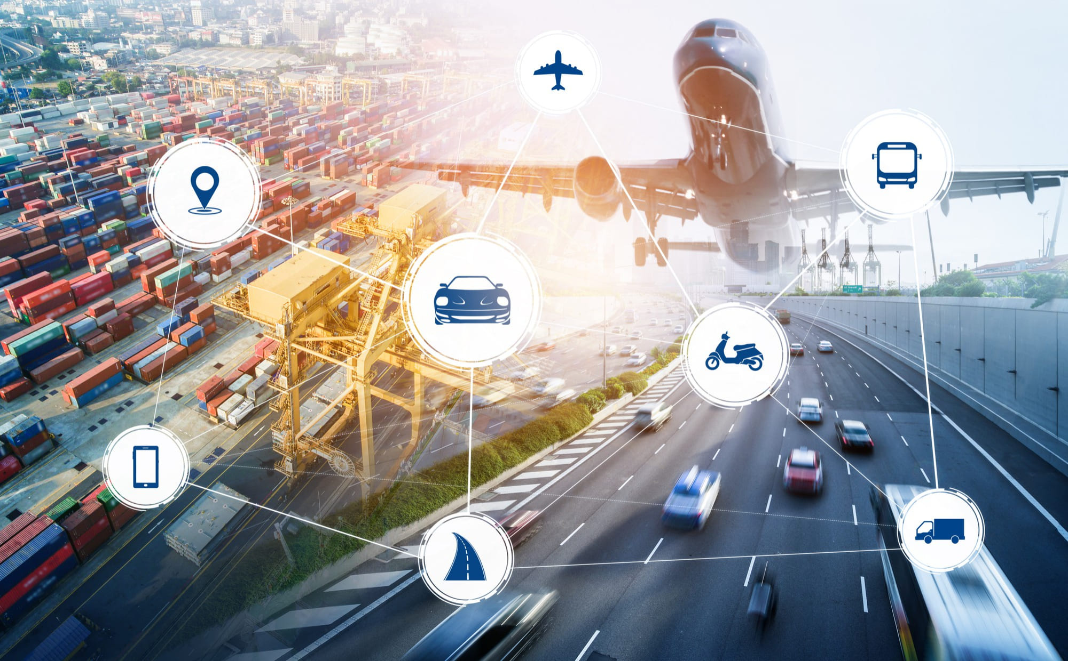
SCOPE AND COMPONENTS OF DIGITALIZATION
Road, Rail, and Multi-Modal Hubs: Developing a cohesive network that integrates various modes of transport.
Logistics Parks: Establishing facilities that facilitate efficient goods movement.
Climate Change Integration: Aligning transport projects with Sustainable Development Goals (SDGs) to address climate change and promote green energy solutions.

Slide 4
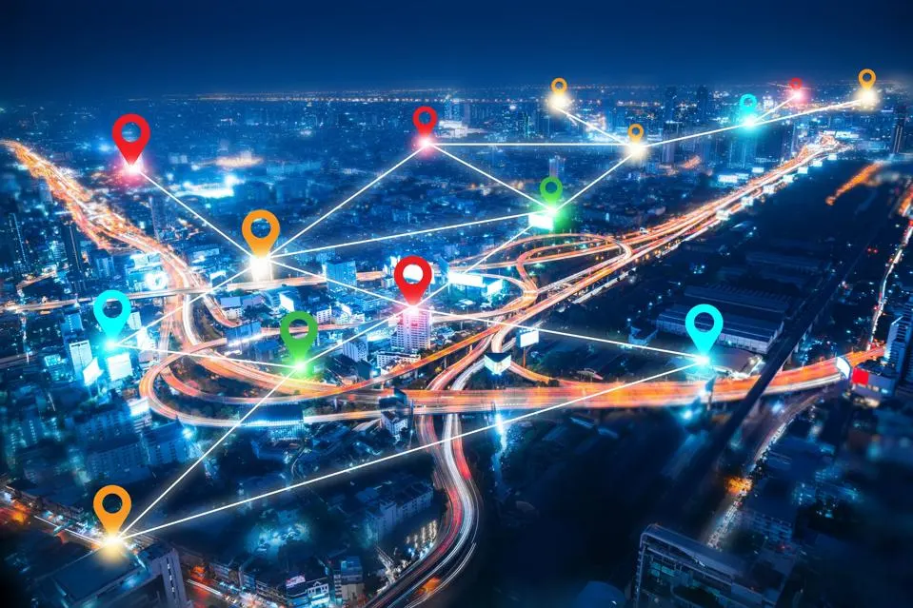
USE OF DIGITAL TECHNOLOGIES
A revolution within the sector it represents the USE OF DIGITAL TECHNOLOGIES
Improve processing efficiency / Artificial Intelligence
Smart Infrastructure & IoT Connectivity
Lower overall costs & enhance productivity
Mobility as a Service (MaaS)
Provide new revenue and value-adding opportunities
Sustainability
Real-time tracking
Blockchain and Secure Payments
Electronic document management
Digital logistics & Cybersecurity and Privacy Protection

Slide 5
FRAMEWORK
Command
ITS/DSS Centre
Regional Architecture
Road
Rail
Airport
Multimodal Hub
Logistics Parks

Slide 6
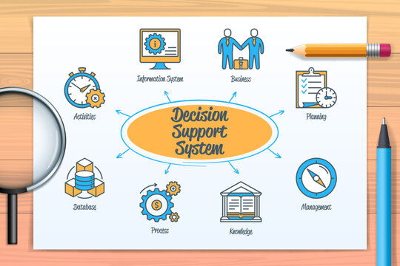
REQUIREMENTS
Software
Installation to all vehicles – Road, Rail and Air
PMIS systems
GIS/GPS/CCTVs
Dashboard for real time monitoring systems
Decision Support Systems
Online monitoring systems
Personnel
Highway and Safety Engineers
IT Specialists – software and hardware
Environment Specialists
Social/Gender Specialists
Procurement Specialist
Integration
Climate Change
Reduction of Carbon Footprint
Sustainable Development Goals
Contributing to Net Zero National Targets
Hardware
Equipment for installation to vehicles
Installation across the country for each category of transport

Slide 7
KEY COMPONENTS OF ITS / MODULES
Licensing / permits
Vehicles
Workshops
Certification
Vehicles
Automobile companies
Workshops
ITS – DSS (Passenger/Cargo)
GPS/GIS
CCTV
Web Portal
Software/Hardware
Procurement
Installation
Commission
Systems
Electronic Management Systems
Weigh in Motion
Transport Violation Systems
RAMs
Environment Database Systems
Road Construction PMS
Structure and Bridge Management System
Road Safety Audit
Traffic Management System

Slide 8
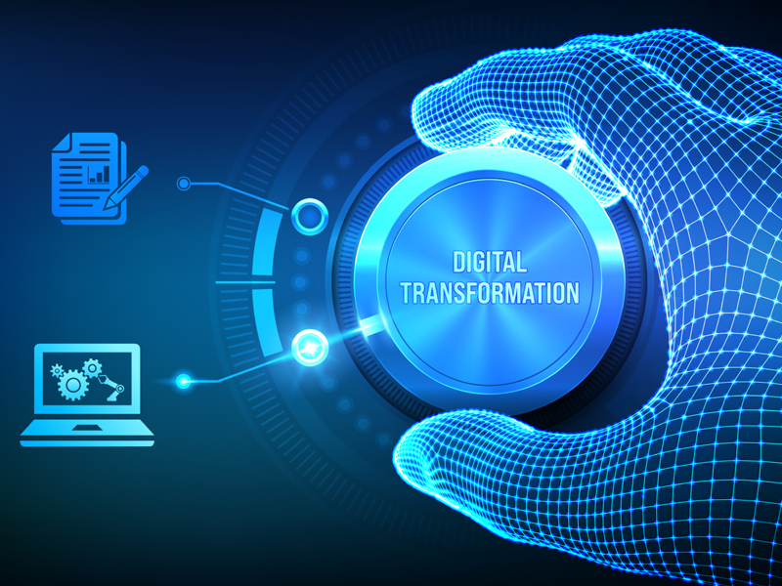
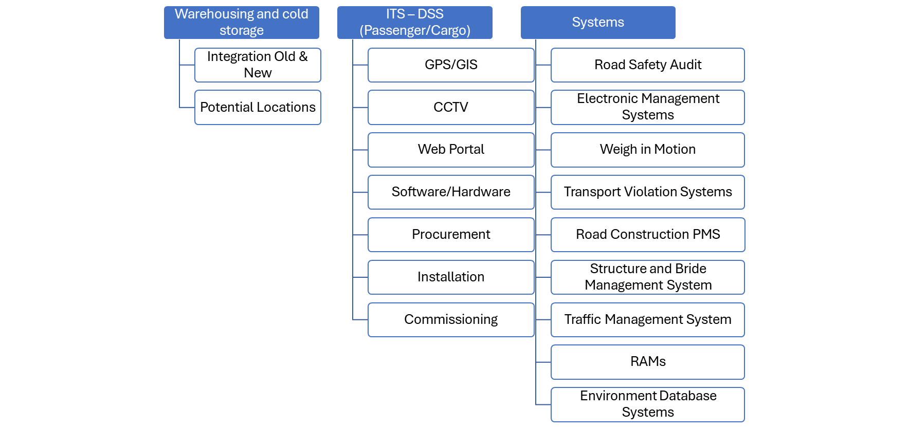
KEY COMPONENTS OF ITS / MODULES
Logistics Parks

Slide 9
CLIMATE CHANGE
SCOPE FOR INTEGRATION OF CLIMATE CHANGE AND SDGs
Climate Change
Reducing Carbon Footprint
Aligning with SDGs
Policy & Advocacy

Slide 10
CLIMATE CHANGE
SCOPE FOR INTEGRATION OF CLIMATE CHANGE AND SDGs
Climate Change
Innovation
Promote Electric Vehicles
Invest in public transportation
Implement smart traffic management
Encourage shared mobility services
Enable remote work and telecommuting
Reducing Carbon Footprint
Promote Energy-Efficient Technologies
Carbon pricing and Regulation
Support Research & Development
Raise awareness and education

Slide 11
CLIMATE CHANGE
SCOPE FOR INTEGRATION OF CLIMATE CHANGE AND SDGs
Policy & Advocacy
Setting emission reduction targets
Regulating emissions
Investing in sustainable infrastructure
Addressing Equity & Accessibility
Monitoring Accountability
Aligning with SDGs
Goals 3, 7, 8. 9, 11, 12, 13, 17

Slide 12
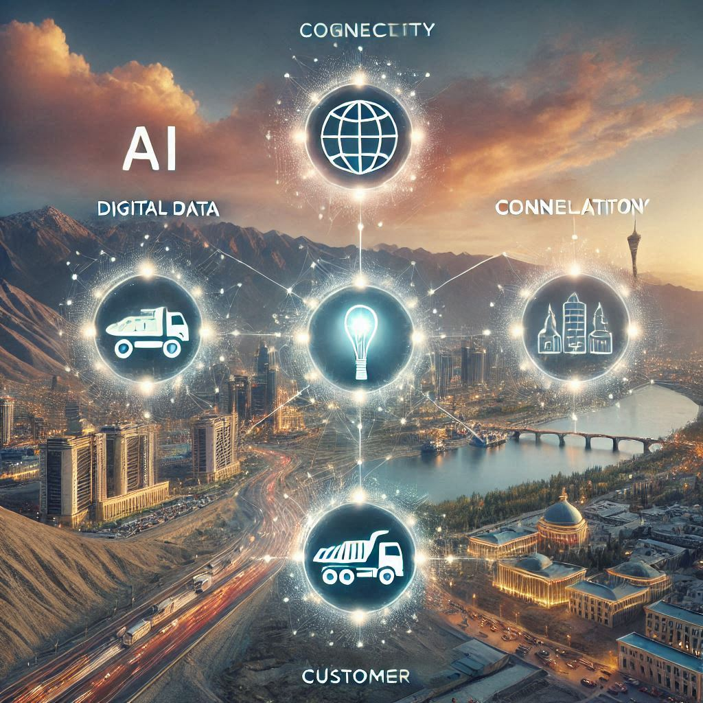
Four levers
Four levers of digital transformation
Connectivity
Automation
Digital Data
Digital Customer Access

Slide 13
Four levers
Automation:
Four levers of digital transformation
Automated Command control Centre
Digitalized Control and Command systems
Electronic signalling
Digitalized Telecom system
Digitalized energy control system
Self-learning systems and AI applications
Digital Data:
Common data base
Big data analytics
Asset inventory management
Monitoring of assets
Forecasting of infrastructure condition
Digital Customer Access:
Electronic Passenger information system
Electronic Freight transport information
Electronic reservation and ticketing
On-time time table information
Digitalized Customer platforms
Infotainment; WiFi in trains, bus stations airport etc.
Connectivity:
Fiber Optic Cable
Internet of Things (IoT)
Cloud Computing
Operations Control for stations and train staff

Slide 14
CHALLENGES
Digital transformation brings numerous benefits, but it also comes with its own set of challenges. Here are some key challenges organizations often face:
Lack of Clear Vision and Strategy:
Resistance to Change:
Technology Complexity:
Skills Gap:
Siloed Organizational Structures:
Resource Constraints
Cybersecurity Risks:
Data Management:
Regulatory Compliance:
Customer Expectations:
Cultural Mindset:

Slide 15
FEASIBILITY STUDY OUTLINE
Road Map
Multi-modal transport system to support an integrated economy
ITS Strategy
Support Transport Infrastructure
Schedule
Time frame & Deliverables

Slide 16
APPROACH
Digitalisation and ITS Strategy
Concept of Operations for the Multi-modal Network
The role of Technology in the Operation of the Multi-modal Network
Create Digitalisation Roadmap and Plan
Create ITS Roadmap and Plan
Detailed Network Plan
Build and Calibrate a Macroscopic model of the selected Multi-modal Network
Carry out gap analysis with respect to the current network
Create Infrastructure Development Roadmap
Multi-modal Network Analysis
Collect data
Identify multi-modal network configurations
Carry out Preliminary Modelling
Select the Preferred Network Configuration through stakeholder consultation
Logistics & Mobility Strategy
Propose Goods & People Mobility strategy
Propose a digitalisation strategy for people and logistics movement
Obtain stakeholder buy-in of the Strategy
Context Identification
Collect sector-wise data on category of goods and people Mobility
Physical Infrastructure Situational Analysis
Digital Infrastructure Situational Analysis

Slide 17
CONTEXT IDENTIFICATION – Physical & Economic
Assess and review the current state of transport infrastructure such as roads, bridges, railways, airports, free economic zones, etc.
Assess and review trade supporting public infrastructure such as dry ports, logistics hubs, inland container ports, border crossings and warehouses
Identify the key movements of people and goods and assess the time and cost for such movements
Understand sectoral growth projections till 2030 and 2040

Slide 18
CONTEXT IDENTIFICATION – Digital & Virtual
Identify procedures and processes for the flow of commercial goods and IT systems that support it.
Identify existing ITS systems, including but not limited to traffic control systems, traffic management systems, tolling systems, vehicle tracking systems and enforcement systems
Identify available datasets, both historic and real-time, data repositories, data standards, data management and privacy policies and data interchange mechanisms

Slide 19
LOGISTICS & DIGITALISATION STRATEGY
Transport & Logistics
Digital Infrastructure
Carry out a gap analysis between physical infrastructure and the desired state – both current and future
Identify options to expand the physical infrastructure, considering the infrastructure in neighbouring and key import/export partner countries and geopolitical factors
Discuss identified infrastructure build strategies with stakeholders so that the stakeholders can choose the desired people and goods movement strategy
Find out the nature of digital infrastructure deployed internationally to support transport and logistics
Identify a subset of digital infrastructure components that are relevant to Tajikistan
Carry out a gap analysis between current digital infrastructure and the desired infrastructure
Create a digital infrastructure development strategy that aligns with the physical infrastructure roadmap, and get stakeholder buy-in

Slide 20
MULTIMODAL NETWORK ANALYSIS
Collect primary data
Traffic counts
Model current network
Encode present multi-modal transport network
Plan future network
Predict future demand for people and goods based on available sector-wise projections
OD for people and goods through sample interviews
Stated preference surveys
Calibrate the model
Validate
Load future demand on the current network to determine gaps
Generate future network models
Generate multi-modal network configurations for the future in line with the people and goods movement strategy to address the gaps
Load predicted demand to generated network configurations and analyse the ease of people and goods movement
Plan future network
Discuss future network configurations with stakeholders
Fine tune the proposed future network based on stakeholder feedback
Finalise the multi-modal transport network roadmap

Slide 21
DETAILED NETWORK PLAN
Model future network
Encode the selected future multi-modal transport network
Project demand
Create physical infrastructure roadmap
Carry out gap analysis with respect to the current network
Do sensitivity analysis and identify critical points in the network
Identify the projects to be undertaken to take the transport and logistics infrastructure to the future state
Determine the timelines for the projects
Role of digital infrastructure
Determine points of inefficiency and vulnerability in the planned network
Create a high-level monitoring and operational control plan
Identify technology systems that can potentially assist in monitoring and operations
Concept of Operations
Determine ITS systems that can assist in network operations
Determine digital infrastructure that can improve physical and cyber security for physical infrastructure

Slide 22
DIGITALISATION & ITS STRATEGY
Digital Infrastructure for Logistics
Networking and Cybersecurity
Data Syndication
Identify existing data standards to be used by Tajikistan or create national standards if required
Determine data sets, both static and real-time that are required for cross-sectoral integration
Data Management Guidelines
Determine IT systems that can ease the flow of goods and improve logistical efficiency in the context of the planned network
Identify digital infrastructure projects and timelines and align them with the physical infrastructure roadmap
Plan a digital network to support the IT and ITS systems in the digital roadmap
Identify cybersecurity systems to be put in place associated with timelines
Define data storage and access for the digital infrastructure
Determine cybersecurity requirements for the planned digital infrastructure through risk assessment and regulatory compliance
Propose a data management policy
Identify key data owners and their responsibilities across key sectors
List data owner responsibilities and protocol for interaction among them
Create a framework for data access guidelines

Slide 23
DELIVERABLES
FIRST PHASE
State of infrastructure report
SECOND PHASE
Primary datasets collected for modelling in a documented machine-readable format
FINAL DELIVERABLES
Macroscopic model of the future network
People and goods movement strategy
Digitalisation strategy
Potential future network layout in GIS format
Selected future network layout in GIS format
Digital and physical infrastructure 2030/2040 vision document
Data standards and data management guidelines document

Slide 24
FEASIBILITY STUDIES – DURATION IN WEEKS
1-2
Project initiation
Project planning
1-6
Stakeholder Classification and Analysis
Stakeholder Mobilisation, engagement and consultations
3-16
Technical Feasibility assessment
12-18
Financial and economic analysis
Environment, Climate Resilience, and Waste Management assessment
Social and Gender inclusion assessment
Review of policies and applicable acts and laws
Policy requirements
Institutional Framework and mechanism
18-24

Slide 25
DELIVERABLES
Inception report (4 Weeks)
Approach and Methodology
Draft Proposal (22 Weeks)
A detailed proposal for the ITS Development, Design, Implementation, Deployment, Operations and maintenance
Final Proposal(24 Weeks)
Obtaining feedback from the IFI and updating the proposal for further submission for funding requirements
Presentation and Workshop (24th Week)
For IFI and MOT
Revised time schedule and finalisation of deliverables

Slide 26
THANK YOU
DTS
Connecting to the Future

