Slide 1





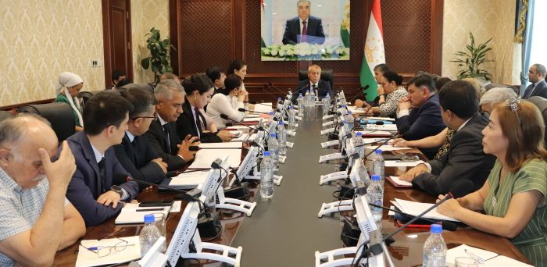
COUNTY PLATFORM INDEX – VOLUME MEASUREMENT INSTRUMENT AND COUNTY CIVIL SOCIETY AND DIALOGUE SQUARE
Dushanbe city on August 13, 2025

Slide 2
"Raising the level and improving the quality of laws, improving the mechanism of their implementation, compliance with the norms of existing laws to the requirements of society and citizens require constant and comprehensive cooperation of all branches of state power"
Emomali Rahmon,
from the message of the President of the Republic of Tajikistan
Majlisi Oli of the Republic of Tajikistan, dated 21.12.2021

Slide 3
National development strategy of the Republic of Tajikistan for the period until 2030. ( p. 3.1. ):
"... Transparency and accountability of the activities of state institutions is an important factor capable of ensuring preventive, industrial and innovative development of the country..."
A weak mechanism for ensuring transparency is characteristic for the activities of state and local authorities
...."
The problem of state administration - "...weak interaction between the state and citizens in the process of national development, including the lack of effective consultation platforms for current communications and strategic task solving..."
Priority No. 1 of the improvement of the state administration - "... the improvement of institutions for the purpose of ... equal access of women and men to decision-making processes that ensure the sustainable development of the national economy..."

Slide 4
REGULATION OF THE NATIONAL DEVELOPMENT COUNCIL PRI PRESIDENT OF THE REPUBLIC OF TAJIKISTAN
(in the edition of the Presidential Decree of RT dated 15.07.2019 No. 1282)
Creation of the National Development Council under the President of the Republic of Tajikistan - a consultative and advisory body
The purpose of the Council : to ensure interaction between state bodies, the private sector and civil society on issues of implementation of the NSR-2030, medium-term development programs of the Republic of Tajikistan and Central African Republic
The members of the Council include representatives of civil society and they can submit their proposals on the implementation of NSR-2030
Civil society also participates in the activities of interdepartmental working groups and closely interacts with industry ministries and departments.

Slide 5
The participation platform is:
platform for interaction of the state with business and citizens for the solution of strategic tasks in separate directions of the functioning and development of the national economy;
the mechanism of public involvement and the process of making administrative decisions;
element of transparency and accountability of the state government system that leads to the improvement of the quality of state government .

Slide 6
The participation platform index is:
the approach to measurement and compliance of the "participation platform" with advanced practices and standards of public involvement and participation and the process of making administrative decisions;
instrument for evaluating the effectiveness of the interaction between the public sector and the public within the framework of the interdepartmental working groups of the National Development Council under the President of the Republic of Tajikistan)

Slide 7
Participation platform index: task
generalize the leading international practice by measuring the degree of involvement and participation of the public in the process of making administrative decisions based on the created formats of the participation of the MRG;
to evaluate the current state of the effectiveness of the interaction of branch ministries and departments with civil organizations and within the framework of the activities of the Ministry of Education;
calculate the Index of the participation platform of civil organizations within the framework of the MRG;
help the leaders of the MRG, civil organizations and all interested partners to determine the existence of favorable conditions for the involvement and participation of the public in the MRG;
identify gaps in the existing policy of public involvement and participation in the MRG and develop effective recommendations for effective interaction within the framework of the entire NR Council under the PRT.

Slide 8



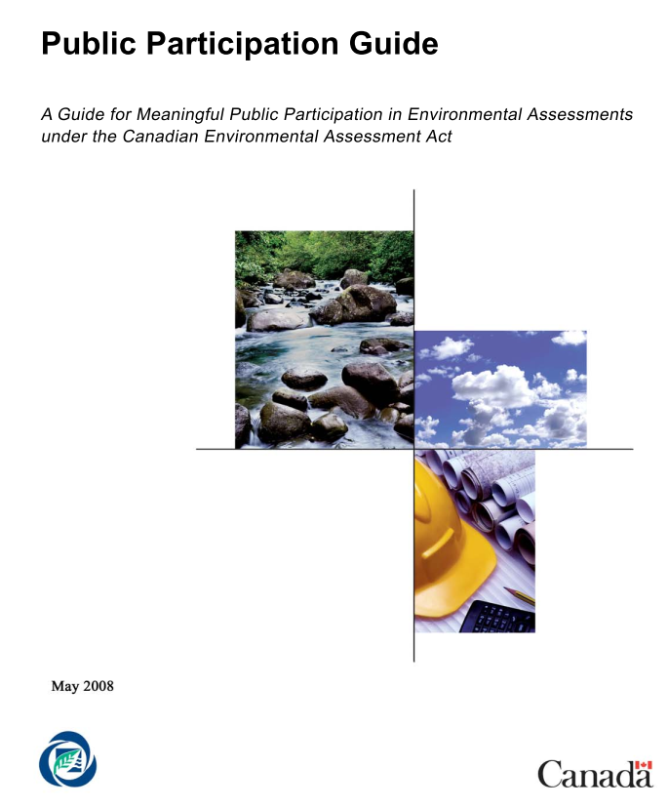
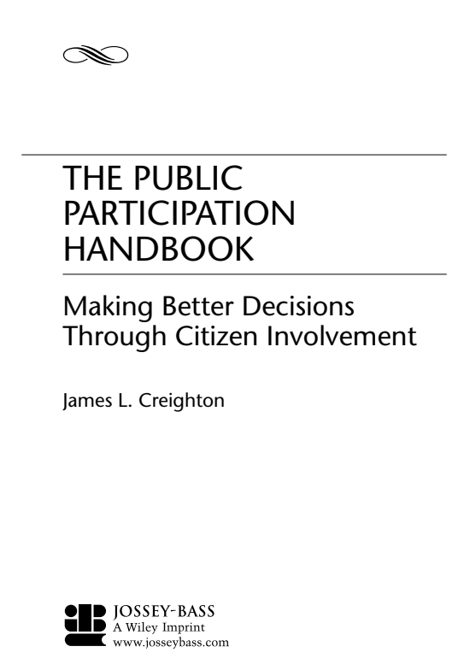




IPU methodological development source

Slide 9
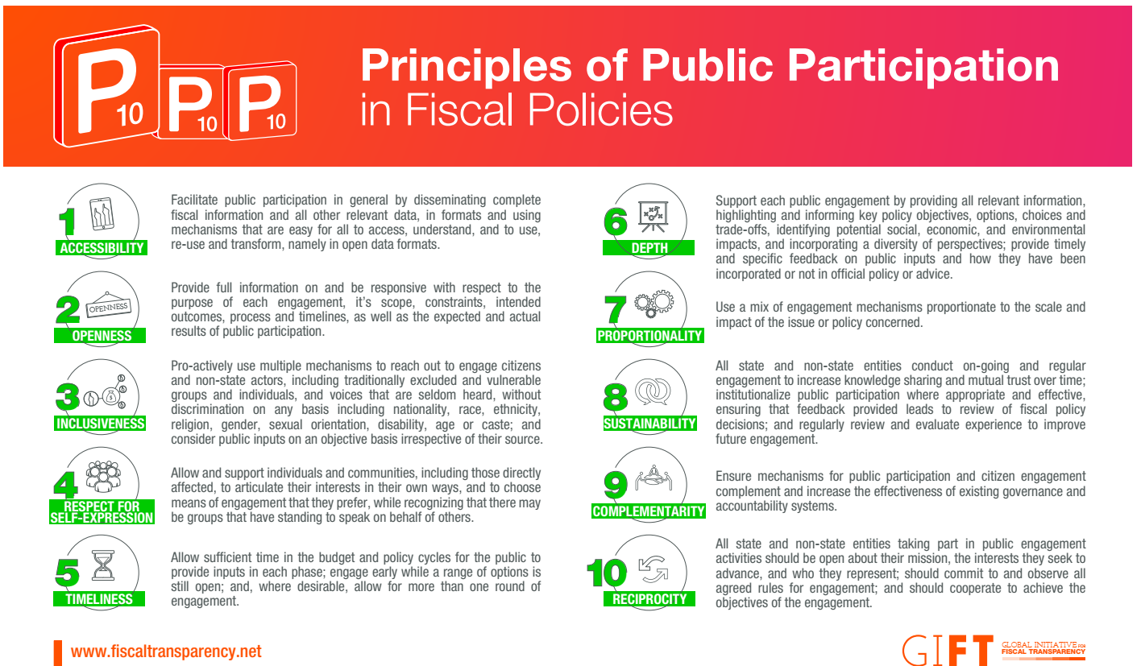
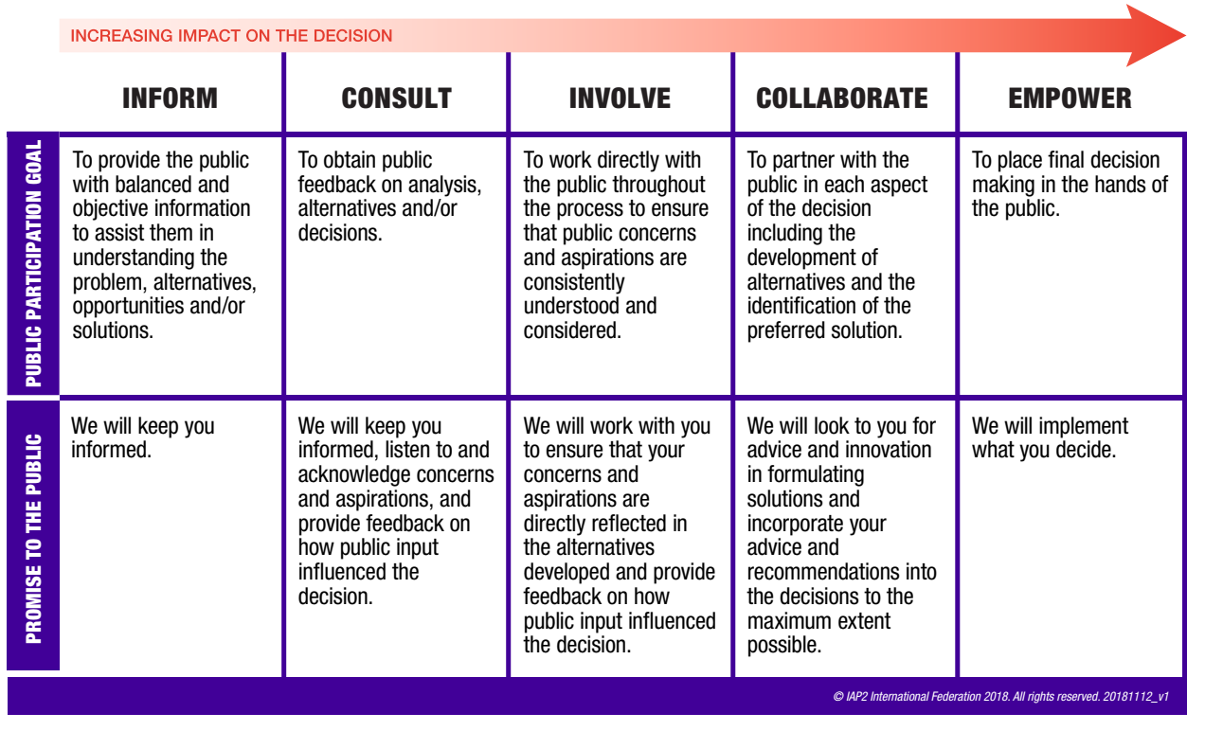
Basic guidelines for evaluating participation platforms:
Guide to the Global Financial Transparency Initiative (GIFT): https://fiscaltransparency.net/public-participation-principles-and-guide/
Guide to values, ethics and spectrum of public participation International Association of Public Participation ( IAP 2).: https://www.iap2.org/page/pillars

Slide 10
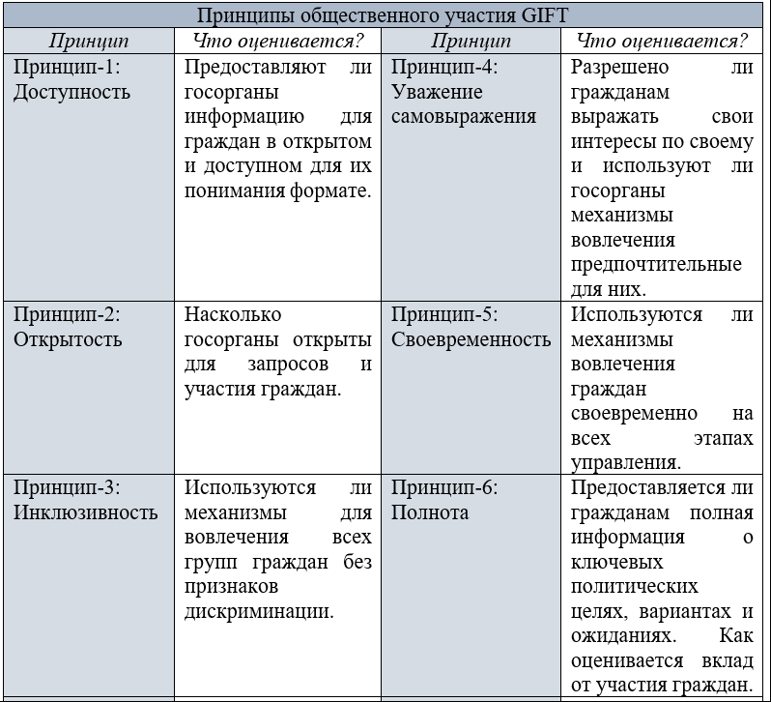
Evaluation of public participation is not based on the guidance of GIFT

Slide 11
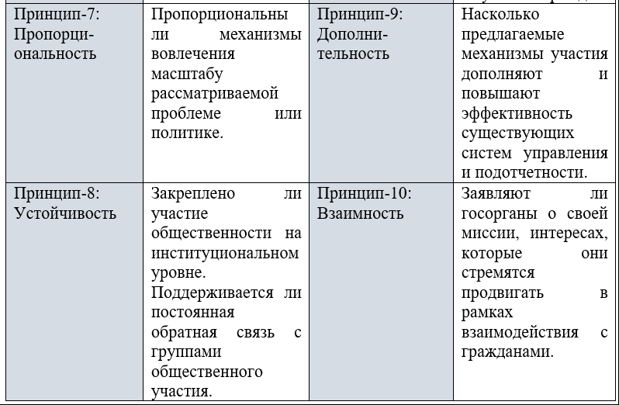
Evaluation of public participation is not based on the guidance of GIFT

Slide 12
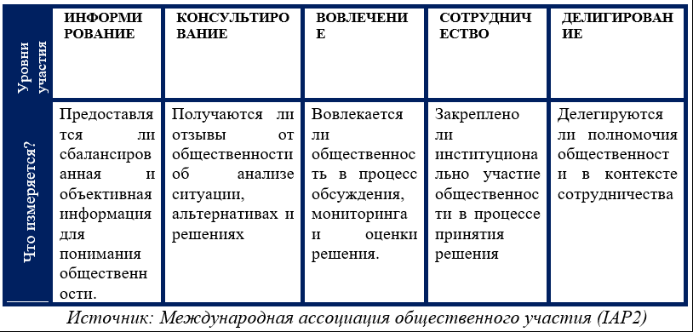




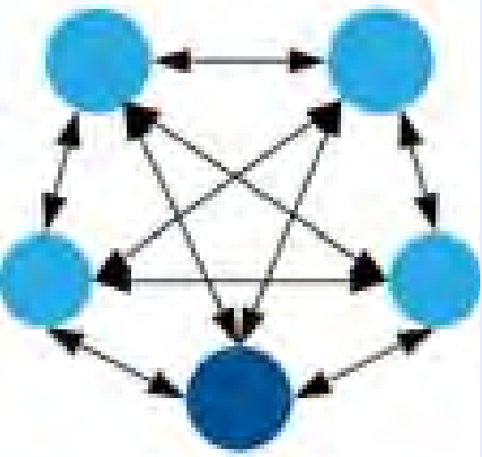
Logical framework of public participation IAP 2
(simplified version)

Slide 13
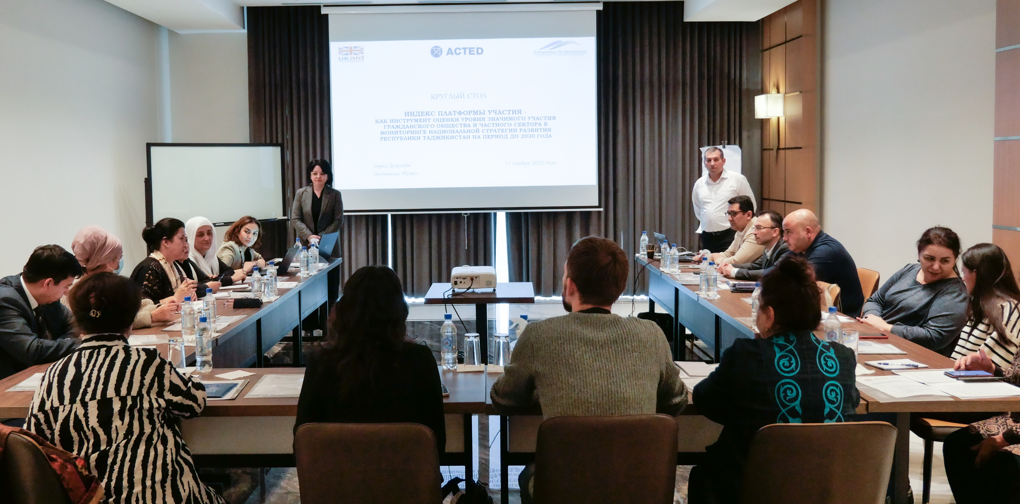
INDEX OF THE PLATFORM OF THE PARTY: information blocks, indicators and sources

Slide 14
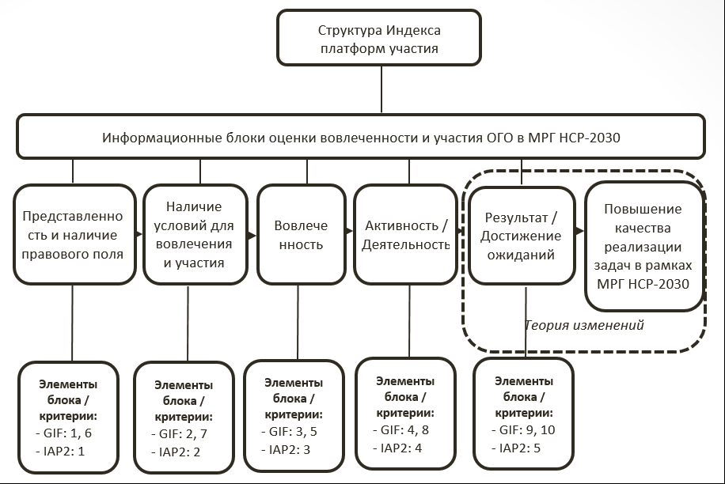

Slide 15





IPU - 20 indicators
Block 1. Representation and presence of the legal field - 4 indicators
Block 2. Availability of conditions for involvement and participation - 7 indicators
Block 3. Involvement – 2 indicators
Block 4. Activity / Activity – 3 indicators
Block 5. Result / Achieving expectations – 4 indicators.

Slide 16
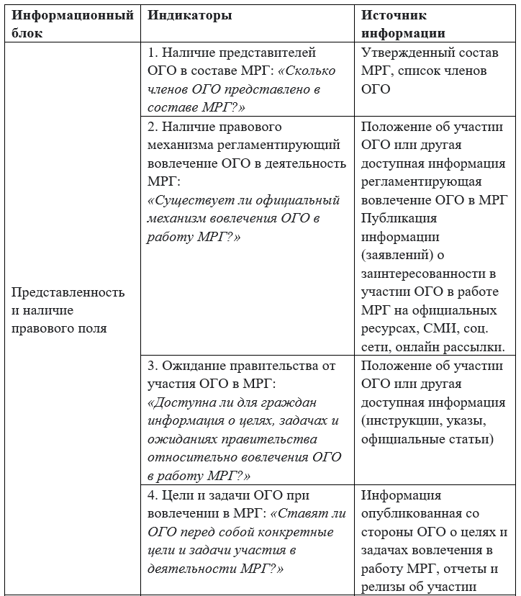
Indicators and sources of information on the evaluation of the index of the participation platform

Slide 17
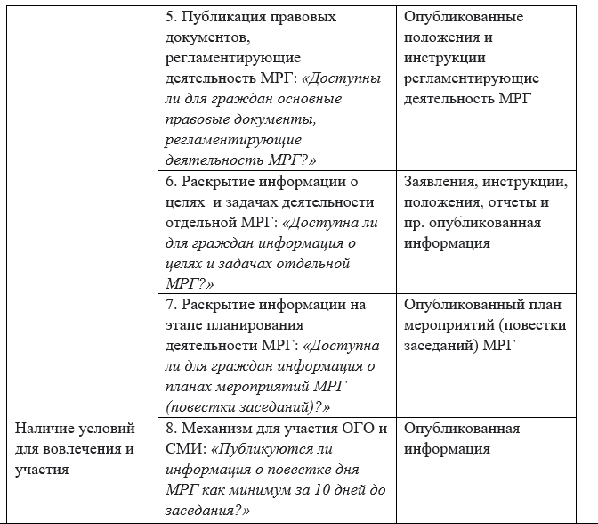
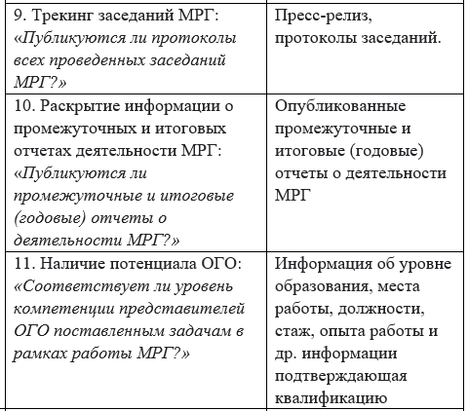

Slide 18
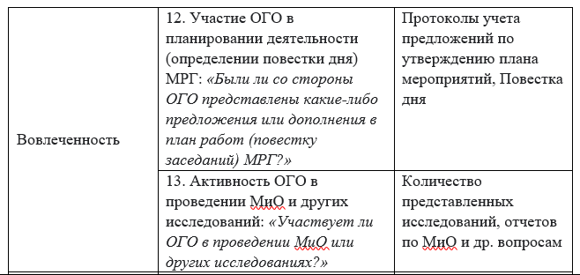
Indicators and sources of information on the evaluation of the index of the participation platform

Slide 19
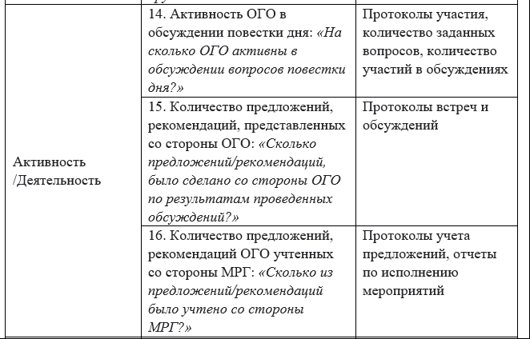
Indicators and sources of information on the evaluation of the index of the participation platform

Slide 20
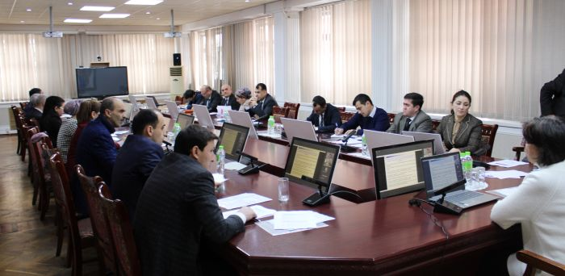
INDEX PLATFORM OF THE PARTY:
THE RESULT OF THE RESEARCH

Slide 21
Source link: https://developmentcouncil.tj/
National Development Council under the President of the Republic of Tajikistan: Regulation of the National Development Council under the President of the Republic of Tajikistan
Information about international organizations - members of the coordination council for development included in the MRG
Functional system of the Council
List of MRG members including state, public and international organizations:
Press-release of the protocol of the meeting
Presentations
Situation

Slide 22
Platform participation index (IPU) – 84.8 / 100
(involvement and participation of civil society organizations in the activities of the MRG of the NR Council under the PRT is not at a sufficiently developed level)
Research results
Representation and presence of the legal field - 91.0 0 / 100 (representation of civil sector organizations in the MRG is not significantly developed, creating significant legal conditions for their involvement and participation)
Existence of conditions for involvement and participation - 83, 85 / 100 (in practice, citizens do not have access to significant information on the stages of regulation, planning, implementation and reporting of the activities of the MRG)
Involvement - 7 7 , 46 / 100 (in practice, there is a significant level of involvement of civil sector organizations in the stages of planning, execution, monitoring and evaluation of the activities of the MRG)
Activity - 77.86 / 100 (in practice, there is quite a high level of activity of civil sector organizations in discussing the agenda of MRG meetings, and presenting proposals and recommendations)
Result - 79.45 / 100 (in practice, the result of the involvement and participation of civil society organizations and the activities of the MRG is estimated as significant)

Slide 23
Index of the participation platform of 14 MRG of the Council of NR under the PRT and its components (in points), based on the results of the 2025 assessment
High
Significant
Satisfactory
Limited
Insufficient or minimal

Slide 24
How much did the participation platform index improve in 2025 compared to 2023? (c ballah)
High
Significant
Satisfactory
Limited
Insufficient or minimal

Slide 25
The dynamics of the participation platform index after 14 MRG in 2025 compared to 2023? (c ballah)
Insufficient or minimal
Limited
Satisfactory
Significant
High

Slide 26
Representation of CSOs in 14 MRGs and the existence of a legal field for the involvement of CSOs in 2025 compared to 2023? (c ballah)
Insufficient or minimal
Limited
Satisfactory
Significant
High

Slide 27
The results of the assessment of separate questions of the block "Presentation and presence of legal field" in 2025 compared to 2023? (c ballah)
Categories of questions | Question
1.1. Presence of CSO representatives in the MRG | 1. How many representatives of CSOs are included in the MRG (%)
 | 2. How many NGO organizations are included in the composition of the MRG (units)
 | 3. Is gender parity observed in the MRG? (%)
1.2. The existence of a legal mechanism regulating the involvement of CSOs and the activities of the MRG | 4. Is there a legal mechanism regulating the involvement of CSOs and the activities of MRG?
1.3. Meeting of the Council / head of the MRG with the participation of CSOs in the MRG | 5. Is information about the goals, tasks and expectations of the Council/leader of the MRG regarding the involvement of NGOs in the activities of the MRG published in practice?
1.4. The goal and task of the CSO with the involvement of the MRG | 6. Do CSOs put concrete goals and tasks in the involvement and activity of MRG?
Insufficient
Limited
Satisfactory
Significant
High

Slide 28
What are the conditions for involvement and participation in 2025 compared to 2023? (c ballah)
Insufficient or minimal
Limited
Satisfactory
Significant
High

Slide 29
The results of the assessment of individual questions of the block "Availability of conditions for involvement and participation" in 2025 (in points)
Question | Ball | Meaning
7. Are the basic legal documents that regulate the activities of the MRG available to citizens? | 96.4 | High
8. Is information about the goals, tasks, members, powers, directions of activity and rules of the MRG meeting available for citizens? | 100 | High
9. Is information about the work plan (schedule of meetings) available for citizens? | 66.6 | Significant
10. Is the agenda of the MRI meeting published? | 92.8 | High
11. Are the protocols of the MRG meetings published? | 92.8 | High
12. Are the interim and final (annual) reports of the MRG's activities published? | 88.1 | High

Slide 30
Involvement of CSOs in the activities of 14 MRGs in 2025 compared to 2023 (in points)
High
Significant
Satisfactory
Limited
Insufficient
Insufficient or minimal
Limited
Satisfactory
Significant
High

Slide 31
CSO activity in the work of 14 MRG in 2025 compared to 2023 (in points)
Satisfactory
No.
Ogre .
Widow.
Meaning.
Vys .
Insufficient or minimal
Limited
Significant
High

Slide 32
Evaluation of the results of involvement and participation of CSOs in the activities of the MRG in 2025. compared to 2023 (c ballah)
Insufficient or minimal
Limited
Satisfactory
Significant
High

Slide 33
Conclusions:
A significant right of institutional openness of the MRG is observed. Between 2023 and 2025, there is a systematic rise in formal opportunities for participation in public organizations (CSOs).
Indicators such as the share of CSO representatives in the composition of the MRG, the presence of a legal mechanism of involvement (from 67% to 97.6%), and the level of information transparency have improved. This indicates progress and institutionalization of civil society participation and development management
The legal and informational bases of involvement are being strengthened.
The presence of regulations, provisions on the activities of the MRG and access to key information (narrative, schedule, composition, goal) reached high values (more than 90 points). This means that the basis for participation is created, but further progress will depend on the real involvement of CSOs in the decision-making process.

Slide 34
Conclusions:
There is a qualitative right of participation of CSOs at all stages of the policy.
The involvement of CSOs in the stages of planning, implementation and monitoring increased from extremely low values (on average 5.8 points in 2023) to 78.6 points in 2025. This right demonstrates the transition from declarative participation to practical contributions of the OGO to the work of the MRG.
There is an increase in the activity and account of the proposals of CSOs.
The activity of OGO in the discussion of the story reached 85.6 points, and until 2023. it was not at the level of 40.29. The number of proposals from CSOs increased more than 30 times, and the level of the MRG account reached 73.9 points - which speaks of the formation of a constructive dialogue between the state and society.

Slide 35
There is nothing more to work on:
The uneven development of the involvement and participation of CSOs is observed in separate MRGs:
- And while in such areas as food security, health care, social protection and gender equality, almost maximum values of the index (over 90 points) are observed, the MRG "Effectiveness of public administration" demonstrates the lack of development and "Financing of NSR-2030" - weak progress.
Problems with transparency and specific elements of activity:
- Despite the generality and openness, important elements - such as the involvement of the number of CSOs in the composition of the MRG, the publication of meeting schedules, the publication of the agenda of the meetings, the involvement of CSOs in the planning and implementation of the activities of the MRG, the publication of meeting protocols, the publication and tracking of considered recommendations and the results of work remain poorly implemented for some MRGs.

Slide 36
Recommendations
Strengthening of interaction mechanisms:
It is proposed to develop and establish standards of CSO involvement and participation - it is possible in the form of a standard provision for CSO participation in the MRG , including: requirements for participation, stages of involvement, criteria for accounting proposals and performance indicators. This will allow CSOs to better understand the Council's expectations of their involvement and participation and, accordingly, interact more effectively.
It is proposed to strengthen the mechanism of interaction through the development at the level of individual MRGs of the Plan of interaction with CSOs and to publish the results of the work - especially necessary for the remaining MRGs. This will allow to implement the mechanism of expansion and rotation of the participation of CSOs and MRGs to prevent "closed groups" and to expand the spectrum of represented points of view.

Slide 37
Recommendations
Support for CSO activities and development of high potential.
My development partner is proposed to be included in the creation and support of the implementation of the micro-grant program for the participation of CSOs in the work of the MRG, including analytical, expert and monitoring activities.
Conduct regular training seminars and training on strategic analysis, development of recommendations and evaluation of state programs, especially in thematic areas where involvement remains low.
Increasing the level of accountability of MRG:
It is proposed to disable the online platform for the publication of agendas, protocols and reports of the MRG, with the possibility of comments and feedback from interested parties.
Strengthen the public mechanism of reporting on the results of the MRG's activities, indicating the number of received proposals, motivated responses to the acceptance or rejection of these proposals. Create a register of proposals and decisions with classification by topic, MRG and year for dynamic analysis and improvement of accounting mechanisms. This will help improve the degree of openness and participation of civil society.

Slide 38
Recommendations for CSOs
Inform about your goals and expectations of participation in the CSO
Actively shares information about his activities in MRG
Invite other CSOs to interact
Actively interact with other CSOs from other participation platforms
Promote the initiative of transparency and accountability in the activities of the MRG

Slide 39
Overall result
In general, the comparative analysis showed that in two years, serious progress was achieved in the institutionalization of civil society participation in strategic management.
However, for a stable effect, it is necessary to proceed from the evaluation of the fact participation in impact assessment participation .
For this, concrete steps are needed: normative consolidation, development of practical accounting of proposals, professionalization of CSOs and direct accountability from the Ministry of Internal Affairs and Communications.

Slide 40

THANK YOU FOR YOUR ATTENTION!

