Slide 1


Ministry of Economic Development and Trade
TASKS AND FUNCTIONS OF THE WORKING GROUP ON ENVIRONMENTAL PROTECTION, EMERGENCY AND CLIMATE CHANGE
ВАЗИФА ВА ФУНКСИЯЊОИ ГУРЎҲИ КОРӢ ОИД БА САМАРАНОКИИ НИЗОМИ ИДОРАКУНИИ ДАВЛАТЇ ВА ВОЛОИЯТИ ЌОНУН
Abduqodir Dostiev - Economic Consultant for Monitoring and Evaluation under the NDC Secretariat``

Slide 2

Main functions of the Group
Review of the implementation process of National Development Strategy of the RT
for the period up to 2030 through mid-term development programs of the Republic
Tajikistan, sectoral development programs, socio-economic programs of the region,
cities and districts and commitments of the Republic of Tajikistan in the framework
of Sustainable Development Goals in the field of environmental protection, emergencies
and climate change
Analysis of the activities of ministries and departments responsible for
the development, processing and consolidation of data according to
action matrix of various programs relevant in this area
Preparation of an interim report on identification mechanism of existing issues on implementation
of strategic documents of the country with the reflection of SDG indicators related to environmental
protection, emergencies and climate change to Secretariat of the National Development
Council for Analysis and Elaboration of consolidated assessment to GOT and NDC

Slide 3

Composition of the Working Group
                Leader of the working group
                Committee for Environmental Protection under the Government of the Republic of Tajikistan
                Members of the working group
                Ministry of Economic Development and Trade of the Republic of Tajikistan,
                Ministry of Finance of the Republic of Tajikistan,
                Ministry of Agriculture,
                Ministry of Energy and Water Resources,
                Ministry of Industry and New Technologies of the Republic of Tajikistan,
                Ministry of Foreign Affairs of the Republic of Tajikistan,
                Ministry of Education and Science of the Republic of Tajikistan,
                State Committee on Investments and State Property Management of the Republic of Tajikistan,
                State Committee on Land Management and Geodesy of the Republic of Tajikistan,
                Committee on Environmental Protection under the Republic of Tajikistan,
                Committee of Emergency Situations and Civil Defense under the Government of the Republic of Tajikistan,
                Statistical Agency under RT,
                Agency for Land Management and Irrigation under RT,
                SUE “Housing and Communal Services”
                Local Development Committee under PC
Private sector and civil society:
Association of Lawyers National Association of Small and Medium Business
Association of Microfinance Organizations National Society of the Disabled
Development Partners
Organization for Security a`nd Co-operation in Europe, World Bank, European Bank for Reconstruction and Development, German Society for International Cooperation, European Union, World Health Organization, International Labor Organization, Asian Development Bank, Family Commissioner for Refugees, United Nations Children's Fund, United Nations, United Nations, Food and Agriculture Organization of the United Nations (FAO), International Organization for Migration (IOM).

Slide 4
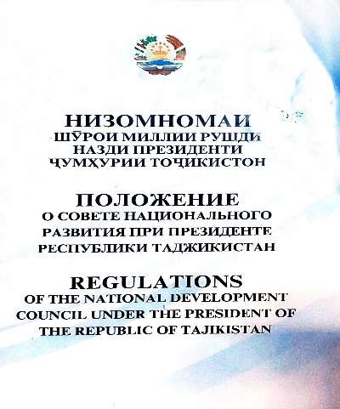
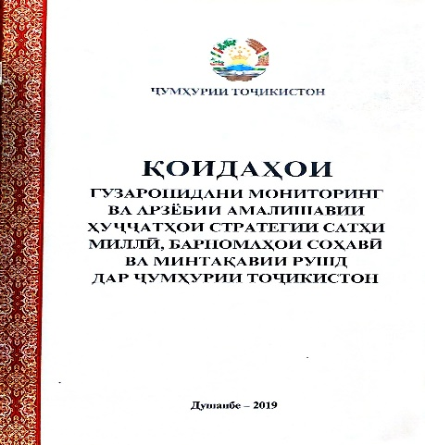
Legal basis of the Working Group
National Development Strategy of the Republic of Tajikistan until 2030 (NDS)
(Approved by the resolution of the Majlisi Namoyandagon of the Majlisi Oli of the Republic of Tajikistan from December 1, 2016 #636)
Regulations of the National Development Council
Rules for monitoring and evaluation of the implementation of national strategic documents, sectoral and regional development programs

Slide 5
Thank you!

