Slide 1

Ministry of Economic Development and Trade of Republic of Tajikistan
Tasks and Functions of the WG on NDS & SDGs financing
Kamoliddin Boziev
Chief Specialist of Department of Regional Development and monitoring of National Programm

Slide 2

Prerequisites for the WG creation
Insufficient coordination on financing the SDGs and NDS (lack of a platform with the participation of all stakeholders
Gap in obtaining data on NDS and SDG financing, especially private sector funds needed to achieve SDG results (46.3%)
The lack of the methodology for determining the cost of some of the activities (in particular institutional activities)
Insufficient capacity of specialists on the linkages between planning and financing in policy formulation and implementation

Slide 3

The main tasks of the WG
Coordination and discussion of NDS and SDG financing issues with all stakeholders
Development of recommendations and making proposals for the development / improvement of funding mechanisms for the NDS and SDGs
Preparation of financial reporting on the implementation of the NDS / MTDP and SDGs (including the development of a reporting format, indicators of the effectiveness of the use of funds aimed at implementing the NDS and SDGs)

Slide 4
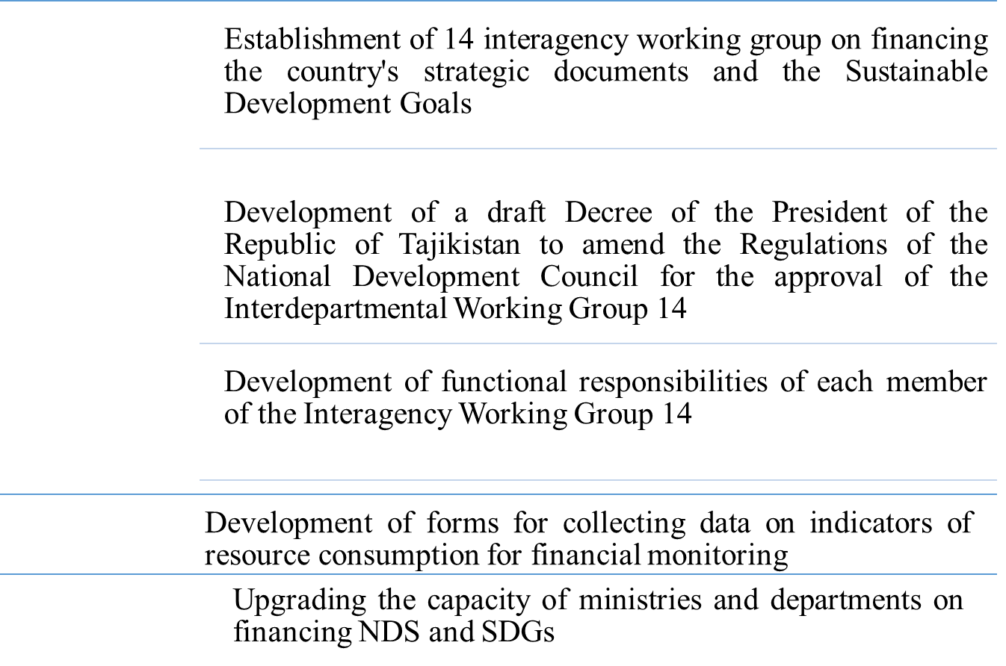

Next steps

Slide 5
Thank you!

